Slide 1


Housing Sale Analysis Project
Real Estate
page 1
A glimpse into the world of property
By Ketan Harale
haraleketan@gmail.com

Slide 2

Problem Statement
Challenge:
Real estate firms face uncertainty in buyer demand across luxury vs. mid-range properties.
Developers struggle to identify the best-performing cities, states, and property features.
Lack of data-driven decision-making for pricing, furnishing, and seasonal sales campaigns.
page 2
Objective:
Analyze housing sales data to uncover market trends, buyer behavior, and strategic insights.
Provide recommendations to optimize revenue and improve sales strategies.

Slide 3
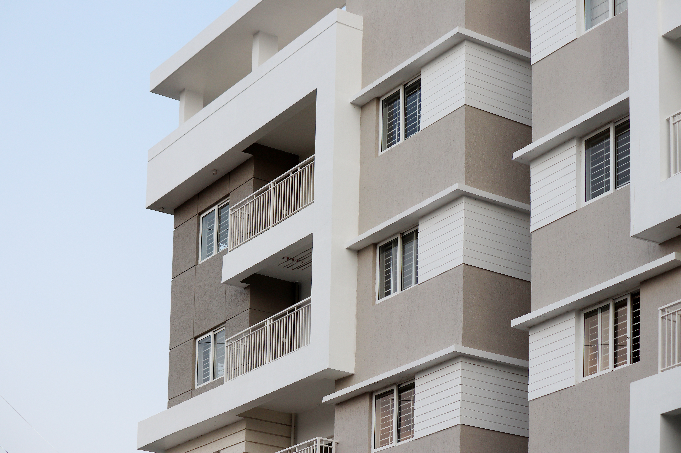
Project Objectives
Understand overall market performance & YoY growth
Identify top-performing states and cities
Compare Luxury vs. Mid-range demand & revenue
Evaluate property features (BHK, furnishing, parking) influencing prices
Analyze buyer behavior (new vs. resale, furnished vs. unfurnished)
Deliver business recommendations
page 3

Slide 4


Dataset Overview
Source: House Property Sales Report (Power BI Dashboard).
Period Covered: 2023–2025.
Records: ~2,500 properties.
Metrics Analyzed:
Total Sales (₹37B)
Average Price (₹14.61M)
Avg Price per Sq. Ft. (₹11.5K)
Property Category (Luxury vs. Mid-Range)
Property Type (Apartment, House, Condo, Townhouse)
Geographic Distribution (State & City)
Sale Type (New vs. Resale)
Property Features (BHK, furnishing, parking)
page 4

Slide 5
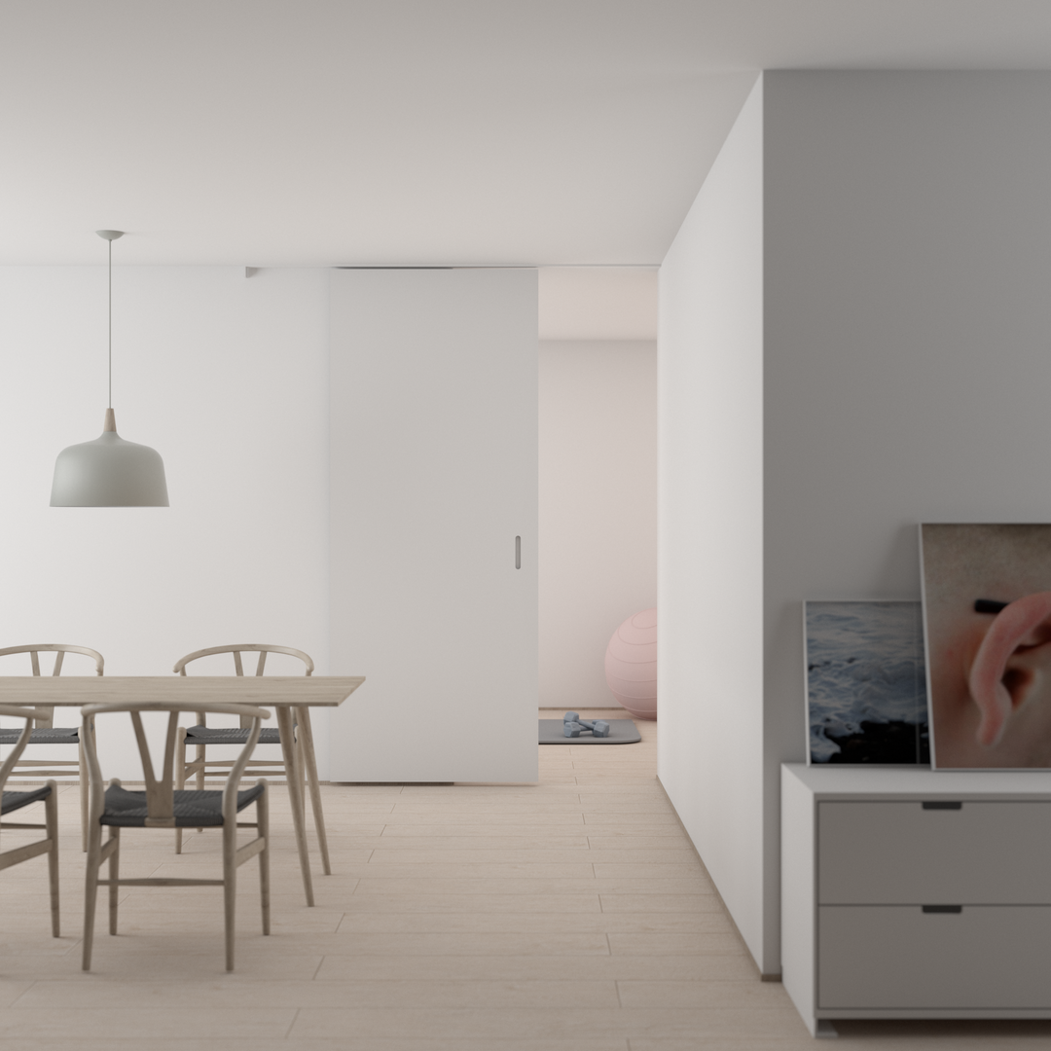
Market Overview
Total Sales: ₹37 billion.
Properties Sold: ~2,500.
Average Property Price: ₹14.61 million.
Average Price per Sq. Ft.: ₹11,500.
YoY Growth (2024–2025): +52.2%.
Insight: The market is in a high-growth phase, driven by both luxury demand in metros and mid-range demand in emerging hubs.
page 5

Slide 6


Sales Trend Analysis
Monthly Sales: Range between ₹2B–₹4B.
Peak Months:
March–April → Financial year-end buying.
October–December → Festive season boom.
Low Months: May–July (monsoon slump).
Insight: Developers should align project launches & campaigns with festive cycles & financial year closing.
page 6

Slide 7


Geographic Insights
Top States by Sales:
Maharashtra (Mumbai, Pune)
Uttar Pradesh (Noida, Lucknow)
Delhi
Haryana (Gurgaon)
Karnataka (Bengaluru)
Top Cities:
Mumbai → #1 in revenue & volume.
Delhi & Gurgaon → Strong in luxury.
Bengaluru & Hyderabad → IT-driven mid-range demand.
Pune, Noida, Jaipur → Strong secondary markets.
Insight: Metro cities dominate luxury, while Tier-2 hubs drive mid-range growth.

Slide 8
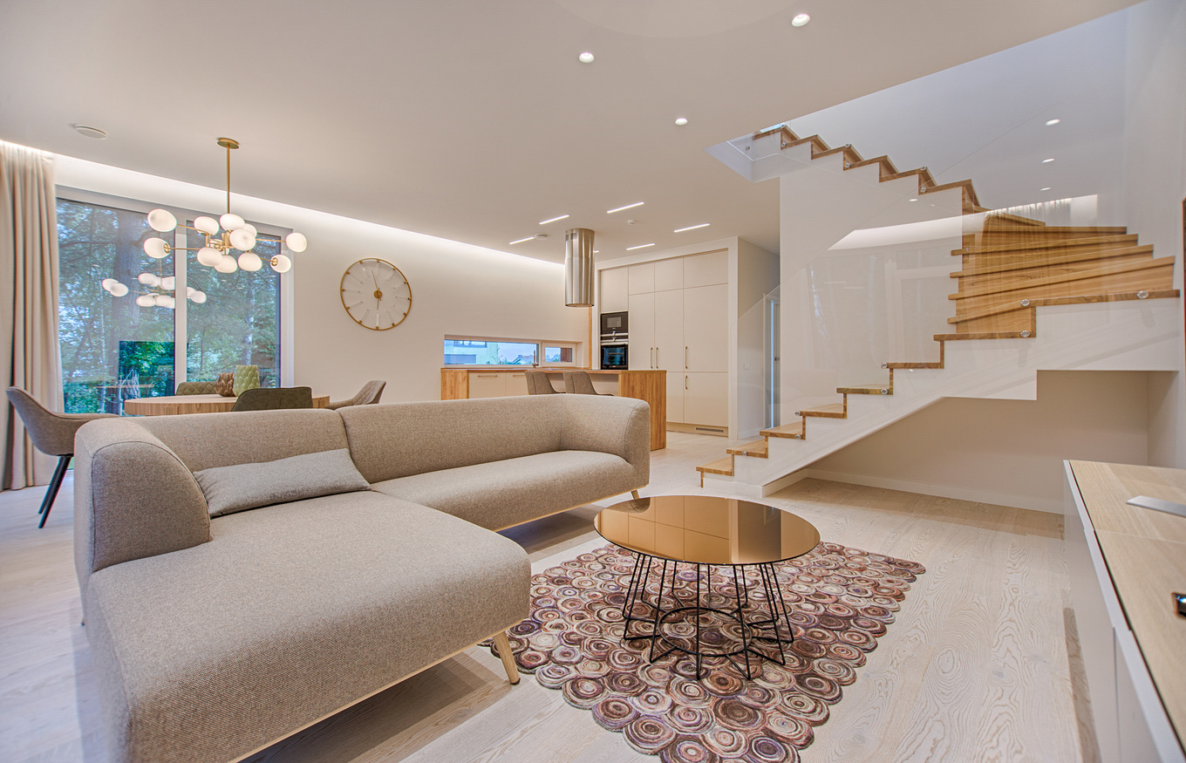
Property Segment Analysis
Luxury Segment:
₹21B sales (58.5%).
~1,000 units sold.
Small base, high-value buyers (HNIs, NRIs).
Mid-Range Segment:
₹15B sales (41.5%).
~2,000 units sold.
Mass market, price-sensitive, salaried professionals.
Insight: Luxury = profit-driven, Mid-range = volume-driven.

Slide 9

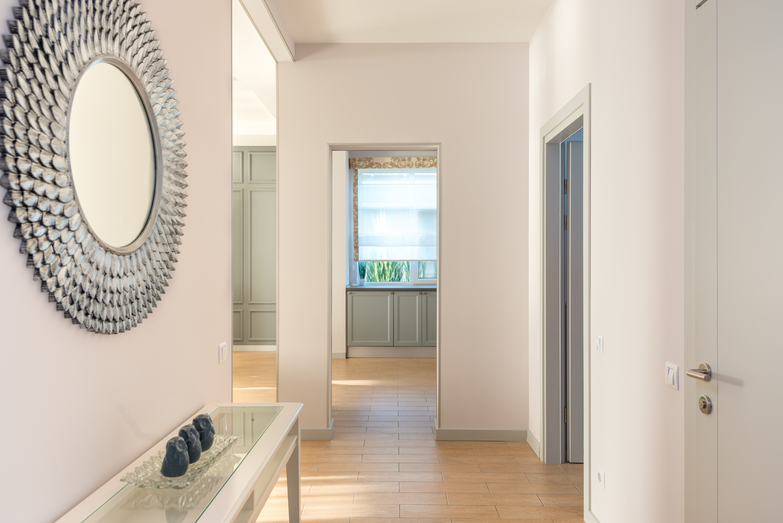
Property Features Analysis
By Bedrooms:
2–3 BHK → Highest demand.
4–5 BHK → Premium, limited buyers.
By Furnishing:
Furnished properties command highest price.
Semi-furnished moderately priced.
Unfurnished mostly investor-driven.
By Parking:
Covered parking = premium price.
Open/None = lower buyer interest.
Insight: Furnished 2–3 BHK with covered parking = fastest-selling inventory.
page 9

Slide 10
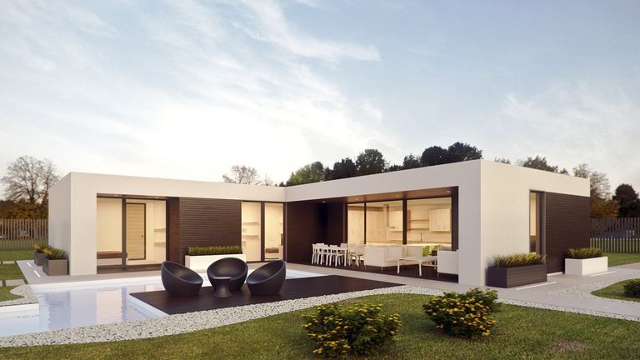

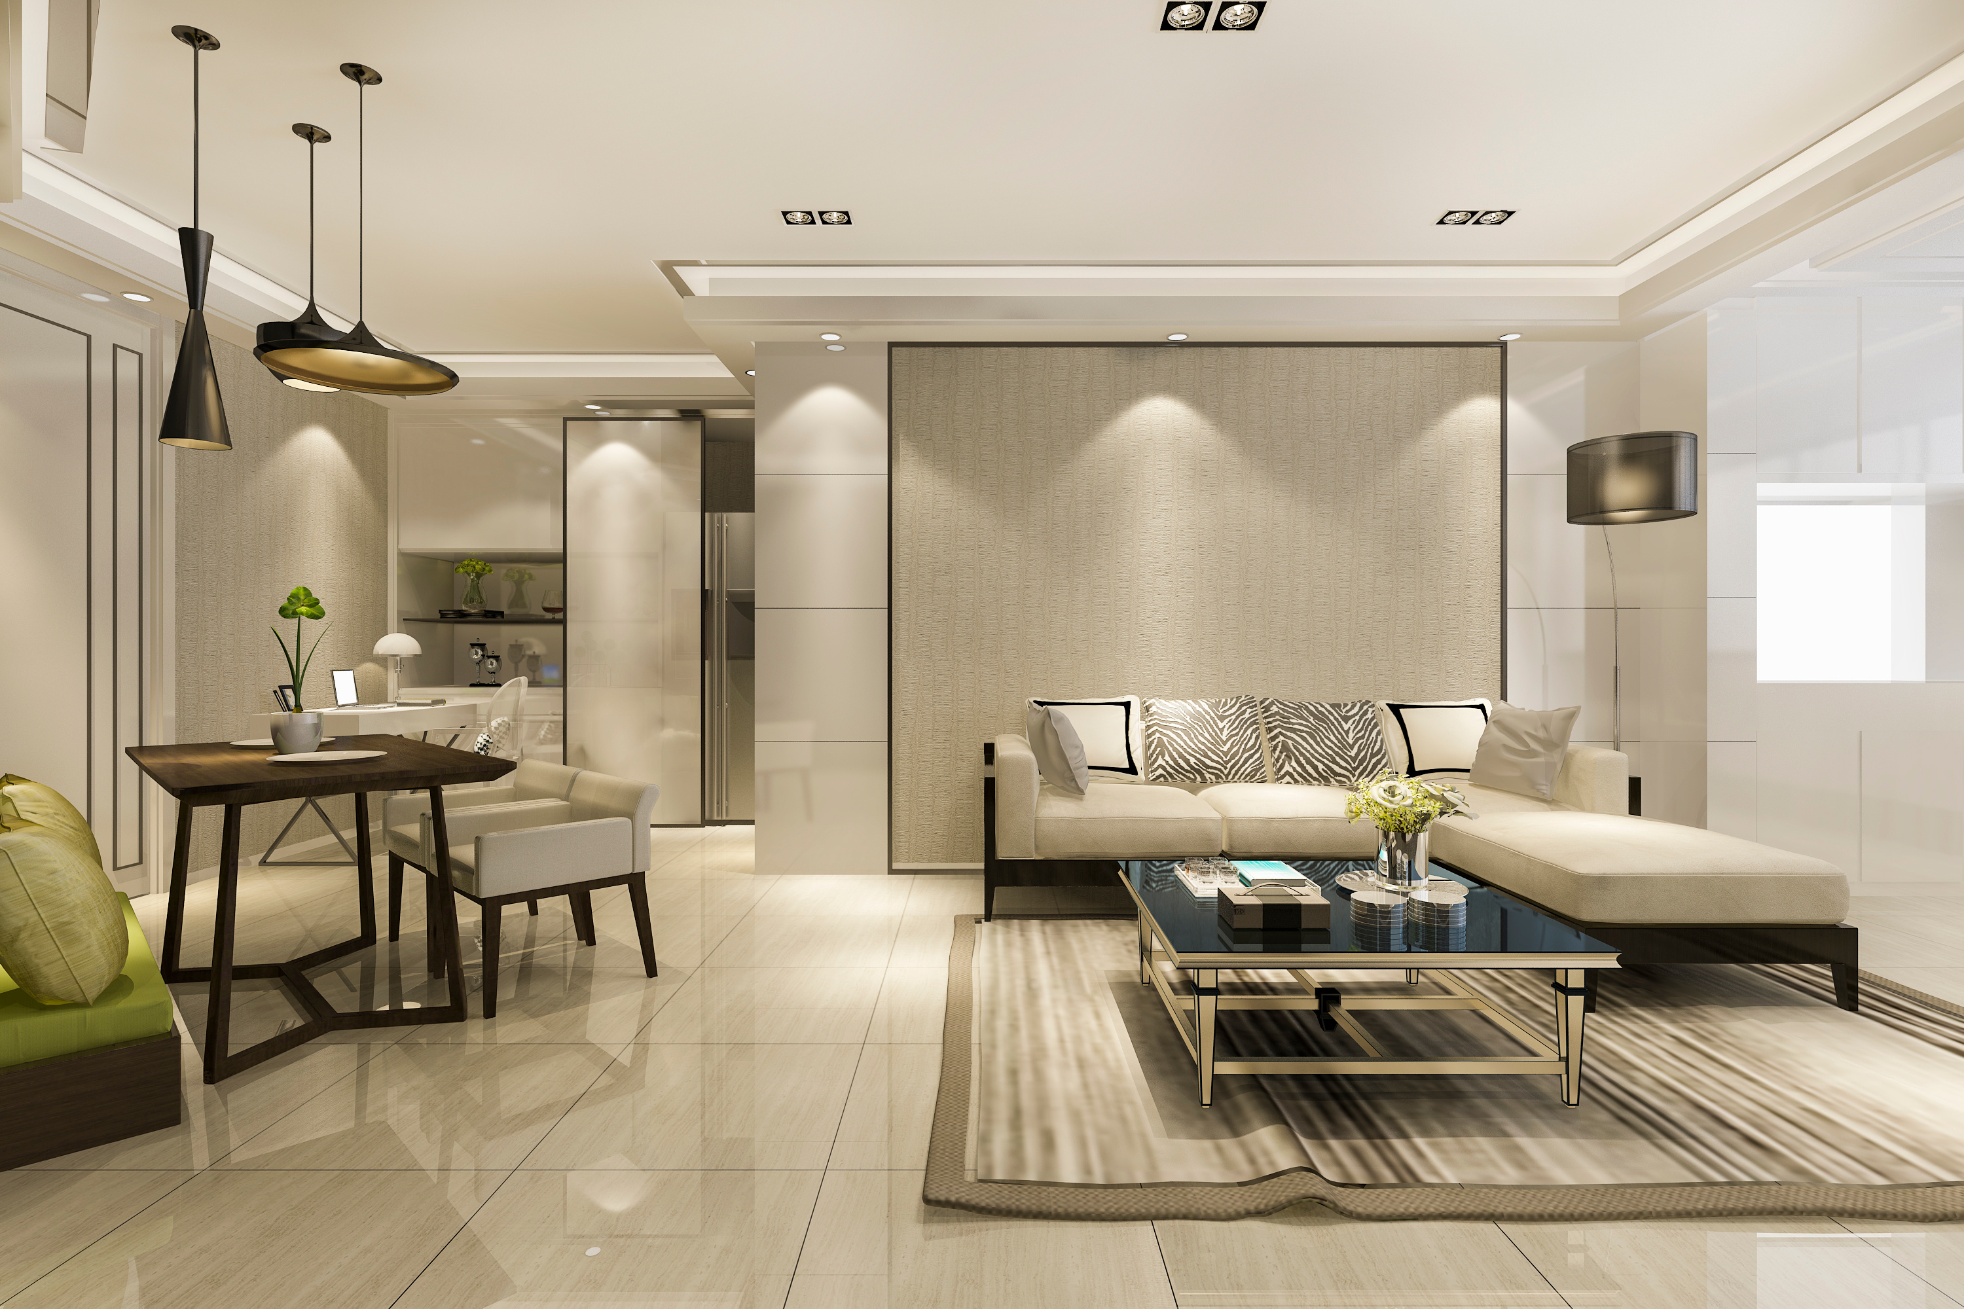

Customer Behavior Analysis
Sale Type:
New properties = 70–75% of market.
Resale = Growing steadily (secondary market expansion).
Buyer Segments:
Luxury → HNIs, NRIs, focus on lifestyle.
Mid-range → Salaried professionals, focus on affordability.
Insight: Growing resale interest opens brokerage & rental-ready opportunities.
page 10

Slide 11
Key Business Insights
Market is booming (+52% YoY growth).
Luxury → high revenue, Mid-range → high sales volume.
Mumbai & Delhi NCR dominate luxury sales.
Bengaluru, Hyderabad, Pune lead mid-range demand.
Furnished 2–3 BHK with covered parking = best-performing product.
Seasonal peaks = festive & year-end.
page 11
www.reallygreatsite.com

Slide 12
Recommendations
Luxury Focus: Invest in Mumbai, Delhi, Gurgaon.
Mid-Range Growth: Push projects in Pune, Hyderabad, Noida, Jaipur.
Product Strategy: Prioritize furnished family homes with parking.
Seasonal Campaigns: Launch offers during festivals & financial year-end.
Resale Market: Build services for secondary sales & rentals
page 9

Slide 13


Conclusion
The housing sector is on a strong growth trajectory. Developers and investors must balance luxury (profit) and mid-range (volume) to maximize returns. Data-driven insights on location, property features, and customer preferences will ensure sustainable growth in a competitive market.
page 14

Slide 14
Thank You.
page 15
Explore endless possibilities in real estate
By Ketan Harale
haraleketan@gmail.com

